Slide 1
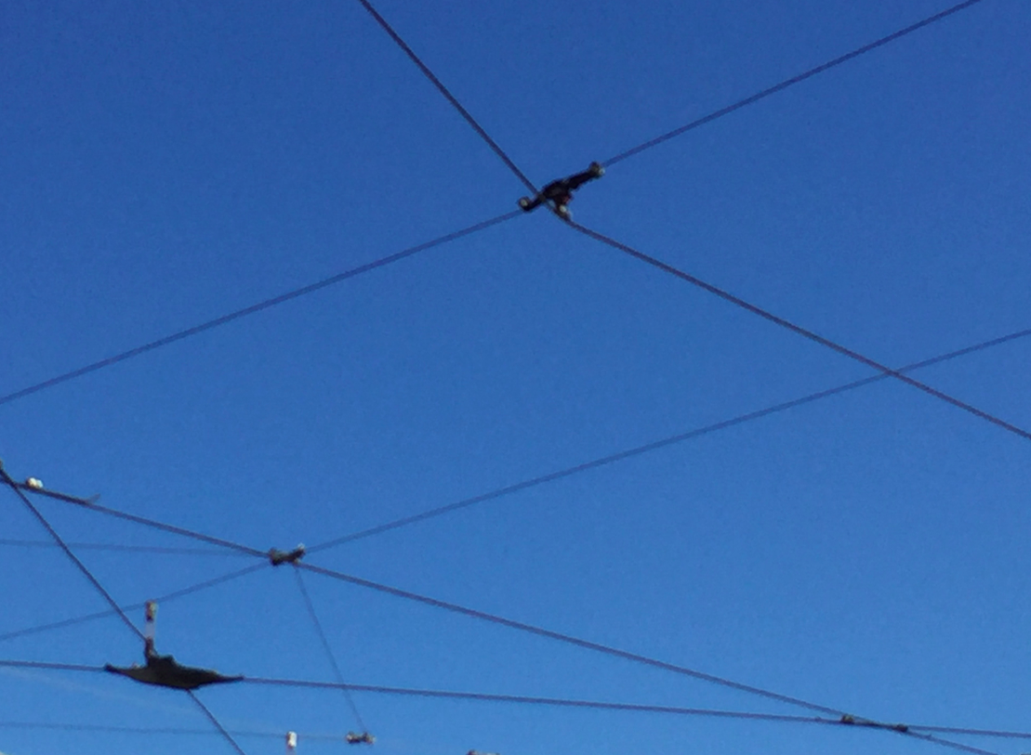
What is Blockchain & why should I care?
Maarten Smakman
msmakman@me.com
Linkedin.com/in/maartensmakman
+31624812267

Slide 2
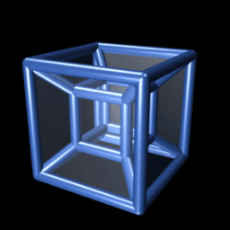
A different ballgame

Slide 3
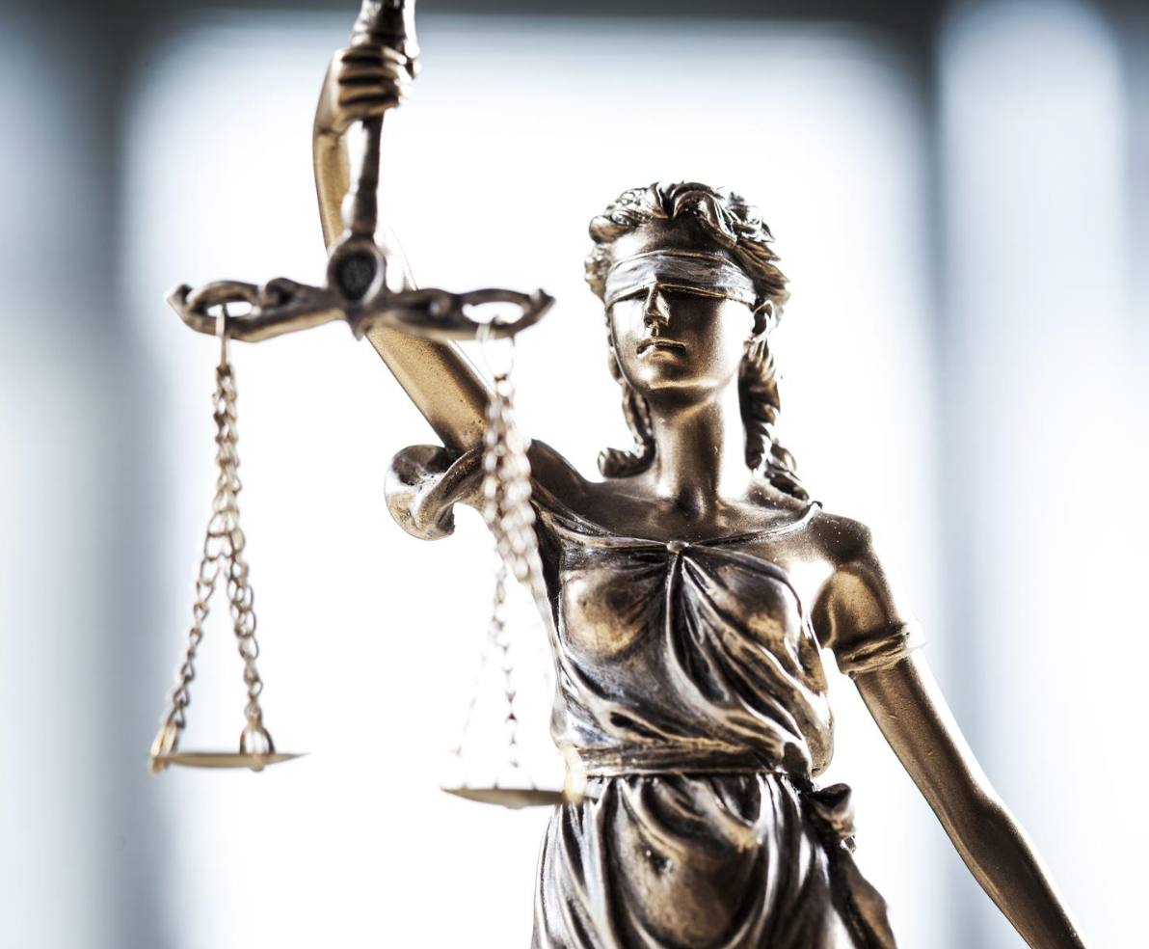
Who, what, why?

Slide 4
What to understand?
1.The concept of blockchain
2. How the technique works
3. Possibilities
4. Meaning

Slide 5
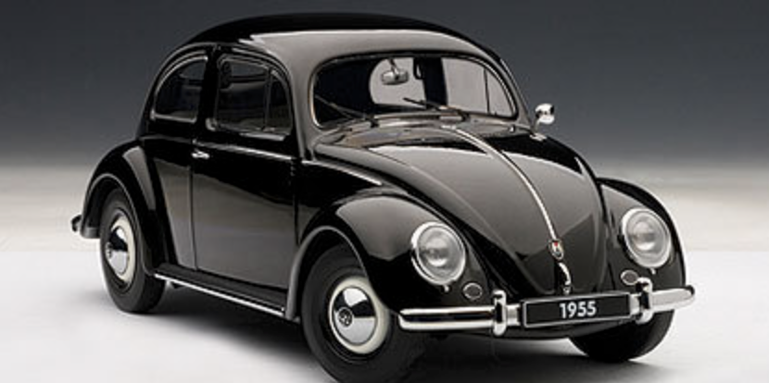
Blockchain = a trustmachine

Slide 6
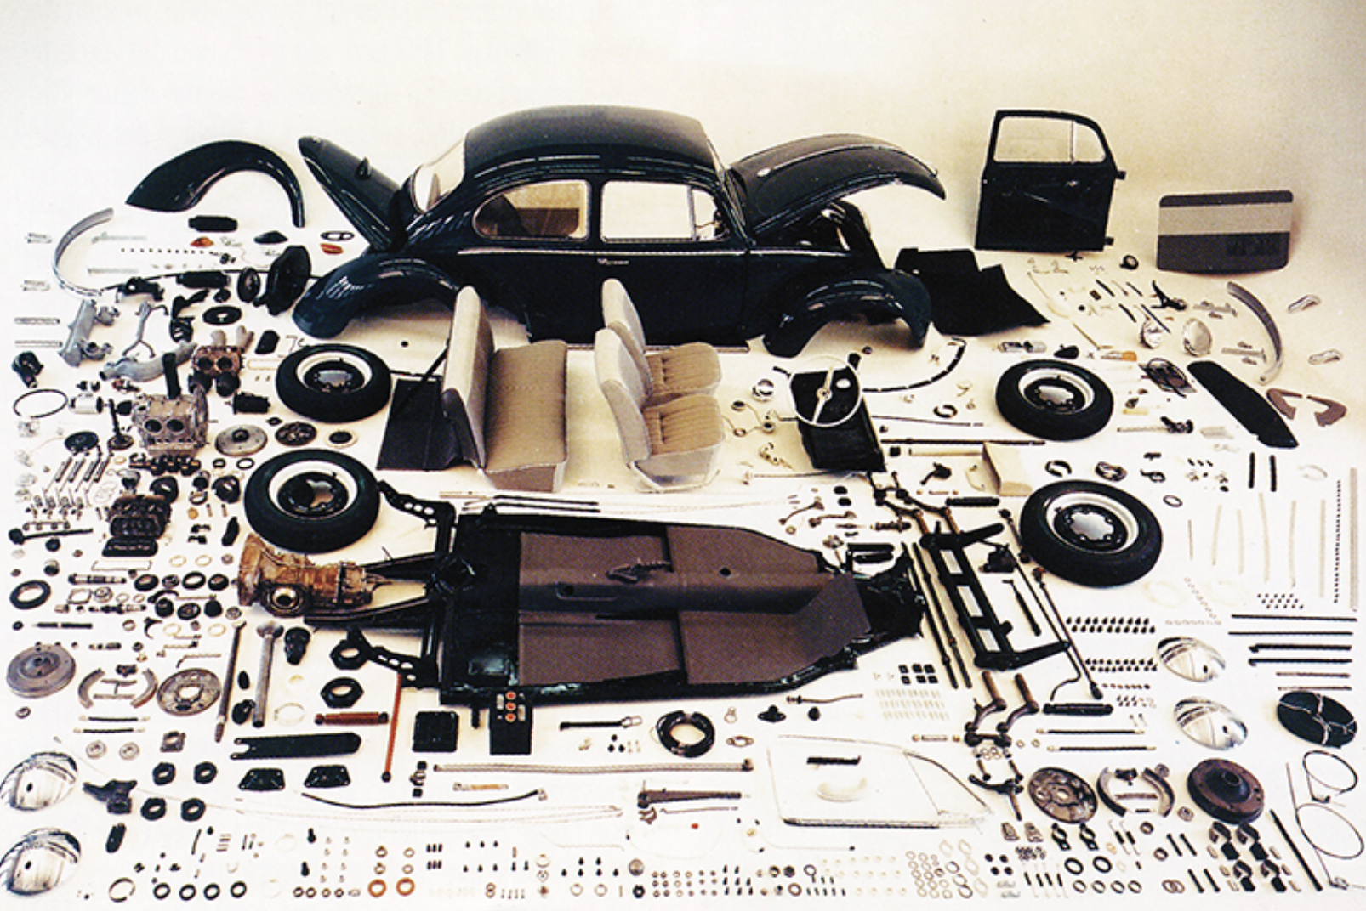
Blockchain = a trustmachine

Slide 7
Blockchain = a trustmachine
A distributed ledger
with a shared single source of truth (time / form)
that is immutable
where (a network of) computers verifies transactions
by a commonly agreed set of agreements

Slide 8
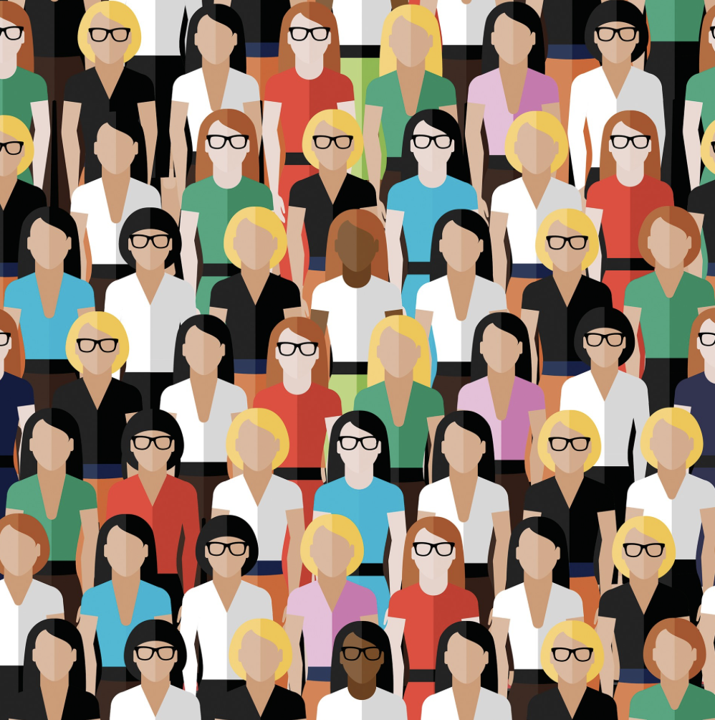
Permissionless

Slide 9
Blockchain = a trustmachine
A distributed ledger
with a shared single source of truth (time / form)
that is immutable
where (a network of) computers verifies transactions
by a commonly agreed set of agreements

Slide 10
Immutability
Correct
Authentic

Slide 11
Blockchain = a trustmachine
A distributed ledger
with a shared single source of truth (time / form)
that is immutable
where (a network of) computers verifies transactions
by a commonly agreed set of agreements

Slide 12
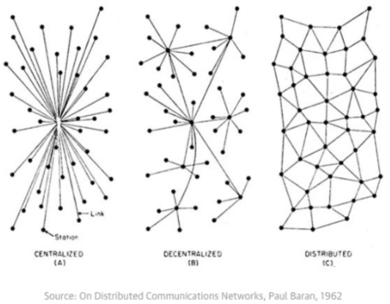
Leaderless

Slide 13
Blockchain = a trustmachine
A distributed ledger
with a shared single source of truth (time / form)
that is immutable
where (a network of) computers verifies transactions
by a commonly agreed set of agreements

Slide 14
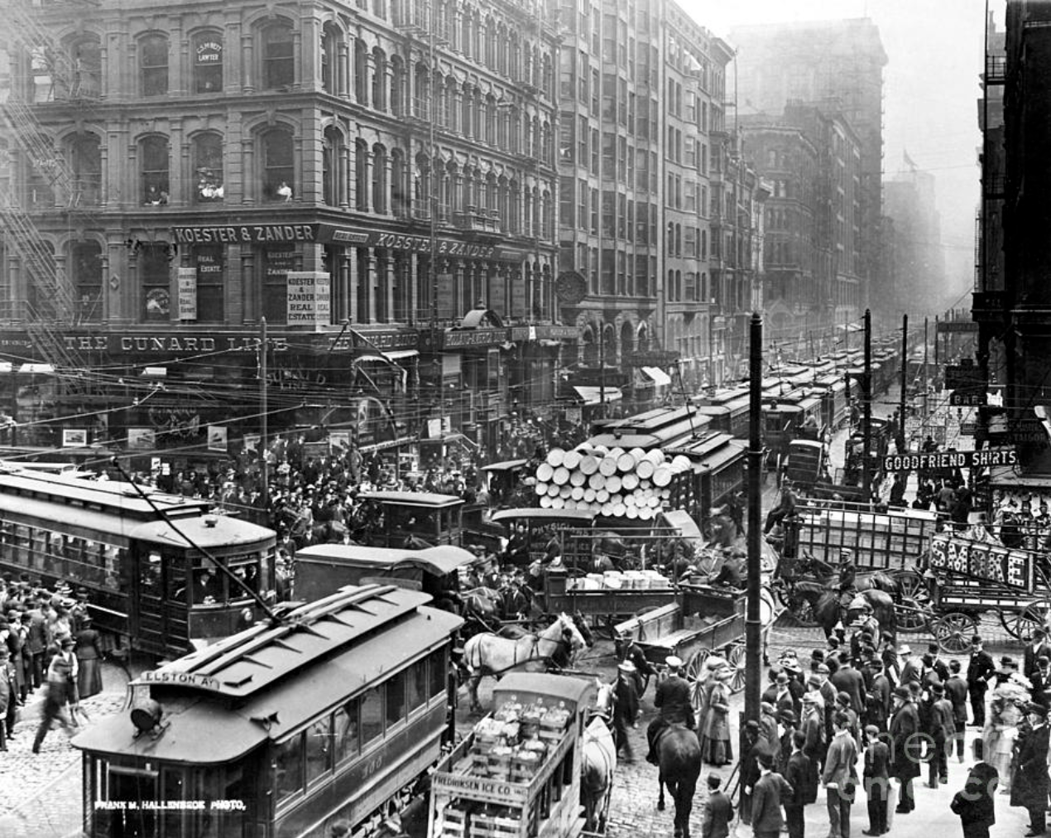
By a protocol

Slide 15
Blockchain = a trustmachine
A distributed ledger
with a shared single source of truth (time / form)
that is immutable
where (a network of) computers verifies transactions
by a commonly agreed set of agreements

Slide 16
Blockchain = a trustmachine

Slide 17
Consequences

Slide 18
In our industrialized society trust is governed in democracies by public and private (trans)national institutions Functioning as middlemen distributing money, power, information etc.

Slide 19
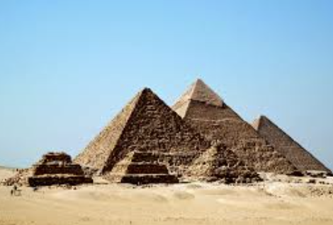

Slide 20
Blockchain can make people coöperate at an unprecendented scale and in unprecedented forms

Slide 21
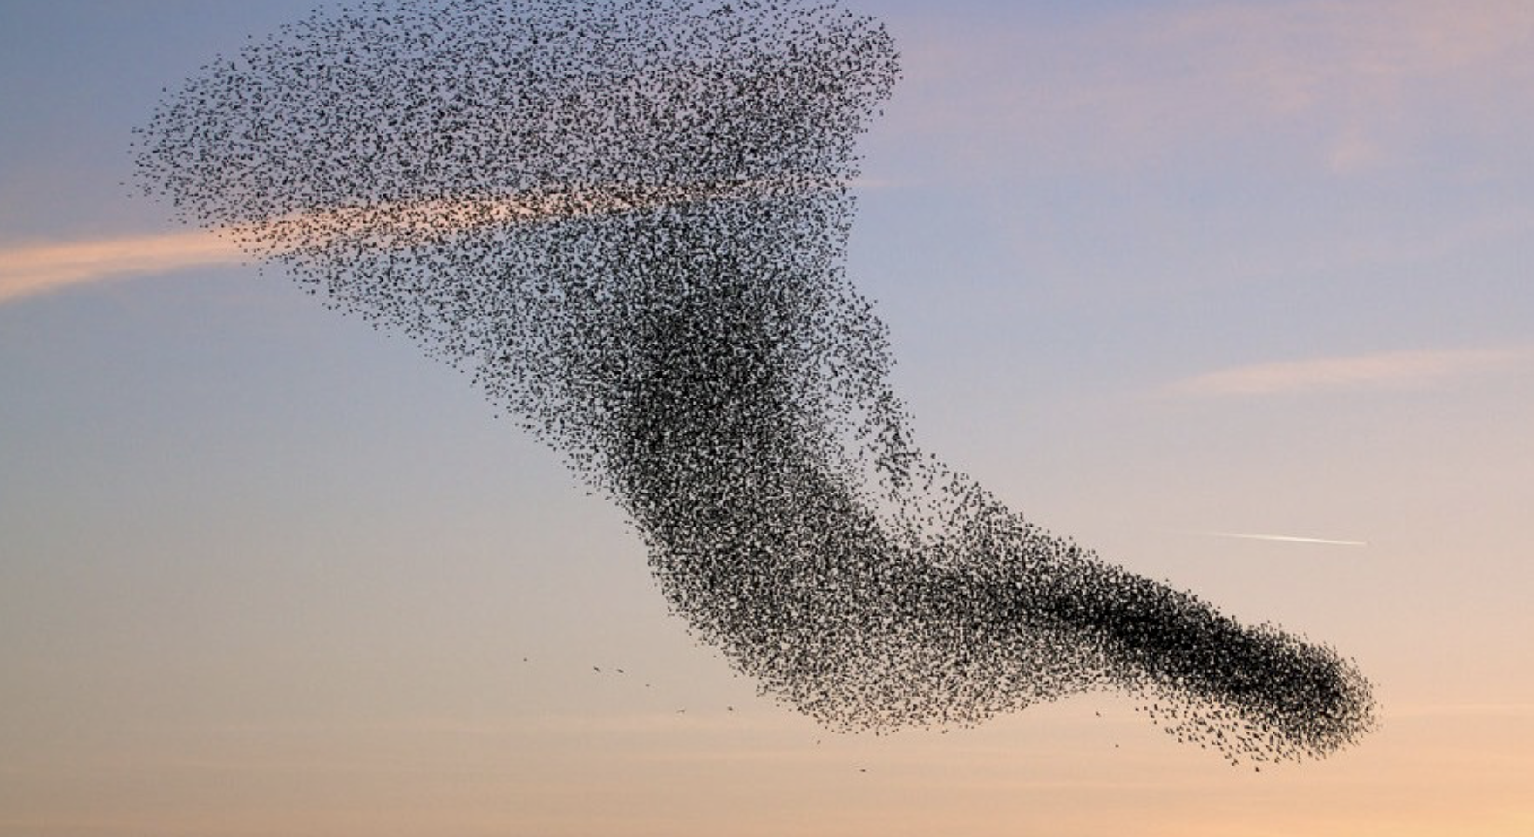

Slide 22
Out of the Trustmachine comes a world without middleman
Banking – Moneytransfers
Accountancy - Supervision
Housing – Real Estate Agents / Notaries
Government - Voting
Law - Contracts
Education – degrees
Journalism – Ownership / Payment of content
Music - Ownership / Payment of content
Gambling – Casino’s
Retail - Authenticity + Origin (diamants, cloting, food)

Slide 23
Meaning for society
This is an unprecented paradigmshift.
Take Bitcoin: an inclusive system without power relations that guarentees free accessibility without censorship by a third party and therefore facilitates a more honest distribution of wealth.
Think of the people in Argentina, Zimbabwe or Venezuela. Or China or Rusland.
No dictators, no monopolies, no bureaucracy.

Slide 24
See what we can’t see

Slide 25
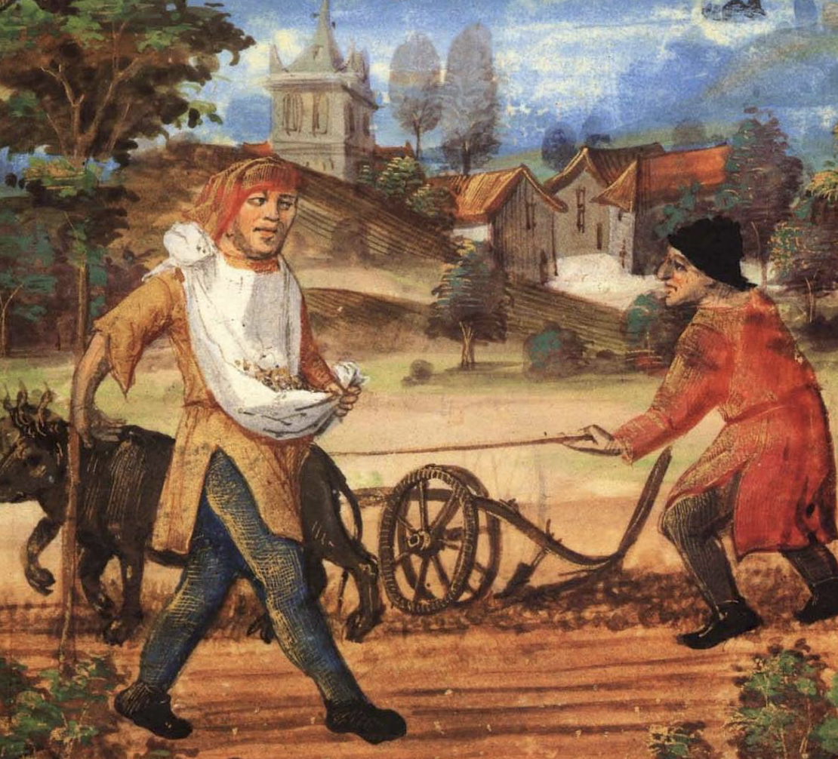

Slide 26
Learn to think differently

Slide 27
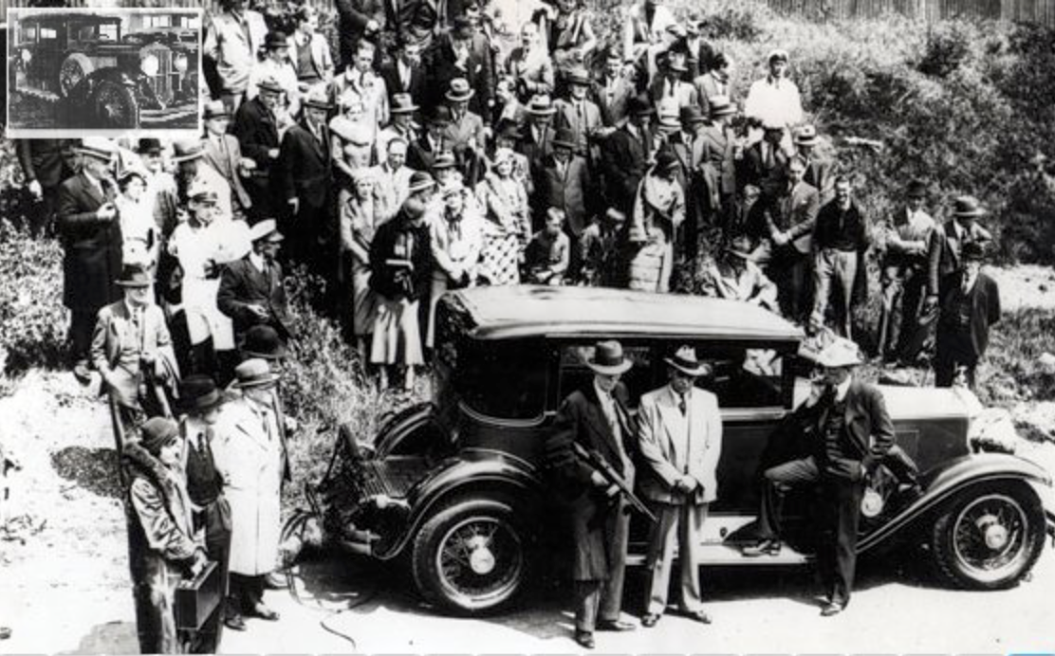
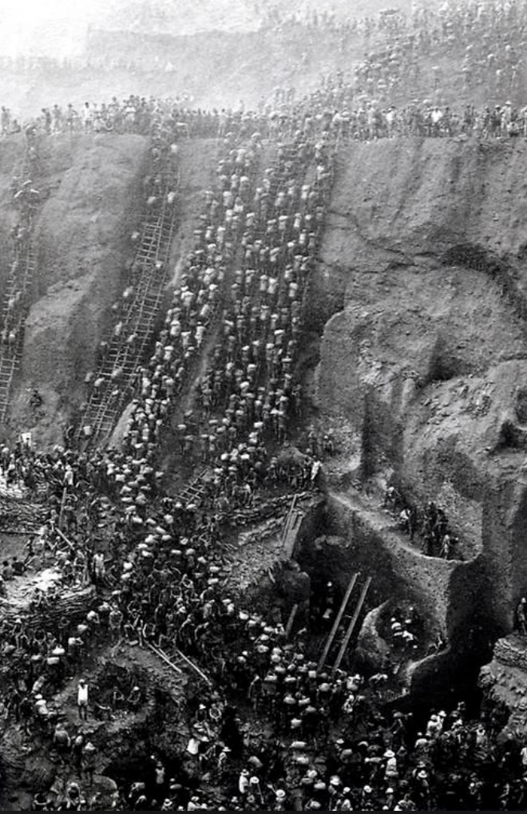
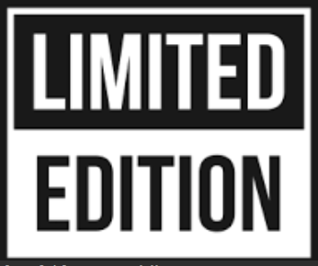
Hype?

Slide 28
Finally
Reading, learning and doing

