Slide 1
Non-payment fintech applications of the the blockchain

Slide 2
Marcin Zduniak
Experimenting with blockchains since 2014
Head of Blockchain at Espeo Blockchain
Senior dev that worked in:
Payments
Banking
Insurance
Mobile and telco
Enterprise integrations
Notes:
First about myself: I am technical guy, worked on various software dev roles and in different industries for around 15 years now. Focused purely on crypto technologies for around 2 years now, but started doing some crypto 4 years back.

Slide 3
10 years
...on the market as Espeo Software
Proven experience in ICO & blockchain projects
Offices in Poznan, Helsinki and San Francisco
Agile specialists
Emphasis on senior-level skills

Slide 4
What do we offer?
ICOs
Technical feasibility study
Tokenomics
Smart contract development
Auditing
ICO page design & development
Blockchain product lab
Blockchain consulting
Prototyping
MVP
Full product development
DApp development
Team training & workshops
Let’s talk about industry-specific use cases!

Slide 5
We’re proud of our work.
Take a look at our
blockchain projects.

Slide 6
CloseCross
Derivatives trading

Slide 7
Derivatives - what’s that?
A derivative is a financial security with a price that is reliant upon or derived from an underlying asset or group of assets. The derivative itself is a contract between two or more parties based upon the asset or assets. Its value is determined by fluctuations in the underlying asset. The most common underlying assets include stocks, bonds, commodities, currencies, interest rates and market indexes.
(https://www.investopedia.com)
CloseCross - derivatives trading

Slide 8
Objectives and requirements
Decentralized, no single centralized entity that is in sole control of the funds and assets
Derivatives that capture crowds’ knowledge change over time
Unlimited number of participants and underlying assets
Support for short-lived (10s of minutes) and long-lived (1 year) derivative contracts
User friendly, appealing to retail and casual traders
Support for 2nd market trading (trading of the trades)
CloseCross - derivatives trading

Slide 9
How does it work - funds pooling?
CloseCross - derivatives trading

Slide 10
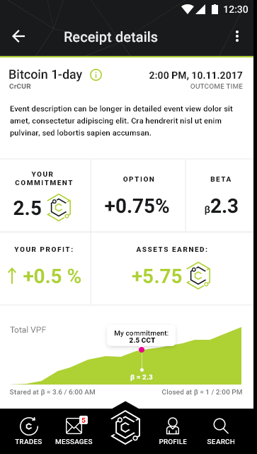
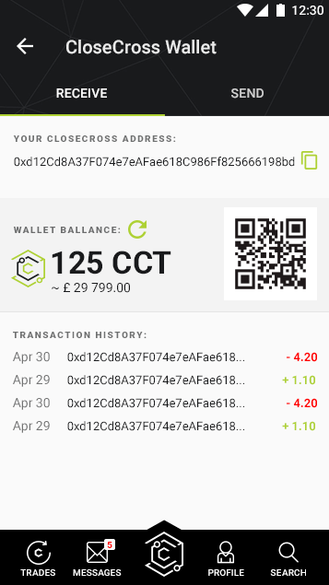
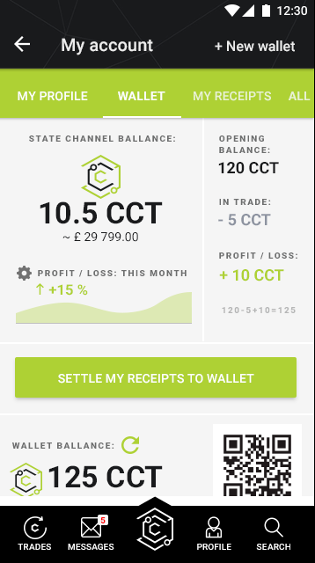
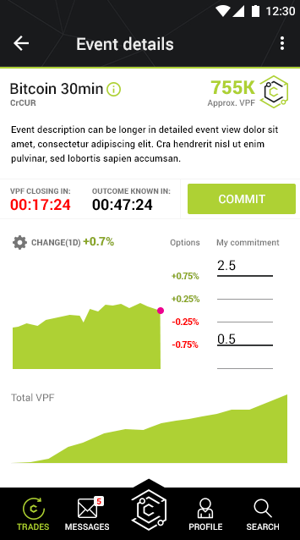
How does it look like?
CloseCross - derivatives trading

Slide 11
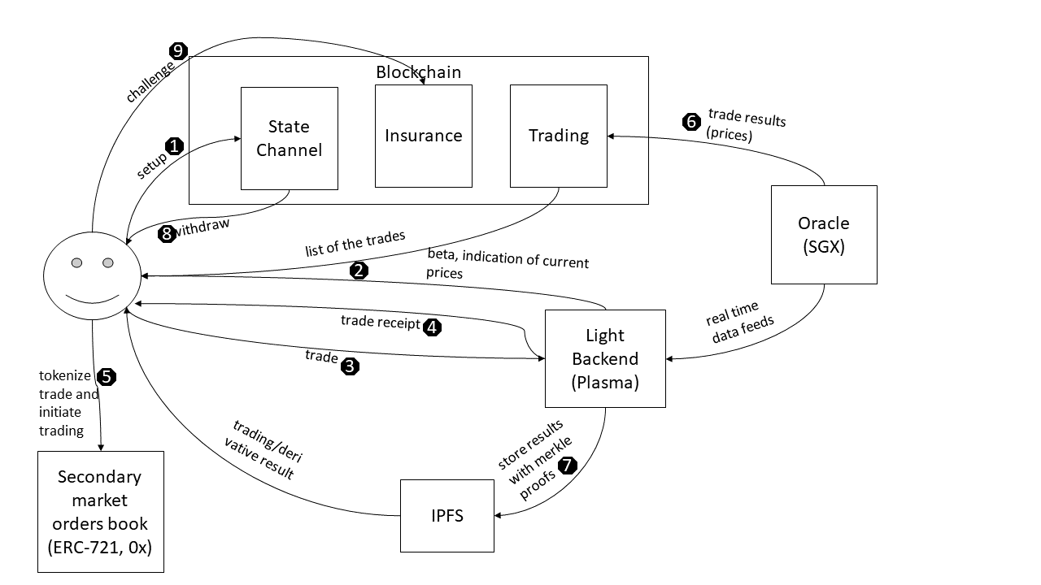
How does it work - integration flow?

Slide 12
Preventable attack scenarios
Platform retaining winning trade but never putting it in the pool of trades
User cheating on the timing of the trade
User trading without funds
User withdrawing more funds then he has
Platform withdrawing user’s funds
Platform refusing to cancel the trade
CloseCross - derivatives trading

Slide 13
Future: ERC-721 and 0x?
ERC-721 not only for CryptoKitties
Each trade can be represented as non-fungible token
beta
what value was predicted for the underlying asset
what was the underlying asset
Plasma to have objective timing, unlimited number of trades and still preserve safety
Private blockchain anchored in public Ethereum
0x to create liquid market for that tokens
off-chain order book and on-chain trades settlement
you can’t cancel your trade, but you can sell it, potentially with the profit
CloseCross - derivatives trading

Slide 14
Tontine Trust
Always funded pension funds

Slide 15
Problem and the solution
The Problem:
Improvements in healthcare means that retirement can now last up to 35 years long
Government pension schemes cannot cope
Even wealthy retirees struggle to understand how to budget for such a long retirement
Current retirement income products such as life annuities are unpopular due to low returns mostly caused by the high costs charged by Insurers
The Solution:
Fully regulated tontine-based investment structure
Administered by unbiased, mathematically robust, self-correcting smart-actuary
Payouts and investment algorithms secured by the blockchain
Assets passing between pool and the ETFs/gold secured by the blockchain
Tontine Trust
Notes:
Tontine Trust - this is a project that tries to tackle problems related to ageing of the societies and how to manage pension funds when there is so many unknowns related to how long person will live.
Current products in this space as f.e. government pension schemes or commercial annuity schemes are very expensive (ie do not offer attractive payouts) and are very risky for the insurer to run.
The proposed alternative here is:
usage of the 300-years old scheme not widely used at the moment, where all the investments are pooled and whenever some person from that pool die that unallocated money of that person generates profits for all the survivors from that pool
funds are allocated according to the investors risk appetite but the general allocation is based on the mathematical algorithm, run on top of the distributed ledger, self correcting to make sure that people’s payouts do not shrink over time when the market is underperforming

Slide 16
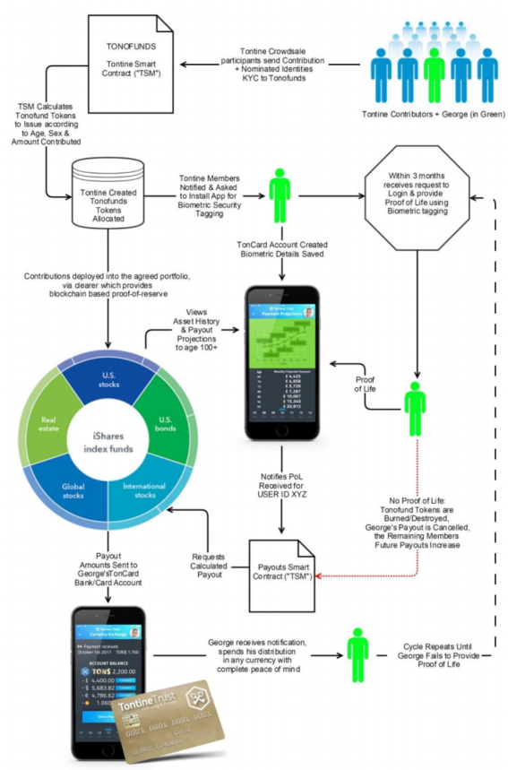
How does it work?
Tontine Trust
Notes:
How it will work:
Tontine Contributors send funds to the fund (crypto, fiat, any)
They have to be fully KYCed and their personal profile anonymized (age, gender)
Basing on the investor profile and amount invested their contribution within the pool are calculated and permanently stored on the ledger.
Contributions are allocated to the agreed portfolio.
In parallel contributor is asked to install mobile app that will be used from time to time for the contributor to provide proof of life.
Every month portion of the investment is reverted back to the pool and paid out to the contributors according to the algorithm that runs publicly on top of the distributed ledger.
The money can be spend using regular debit cards.

Slide 17
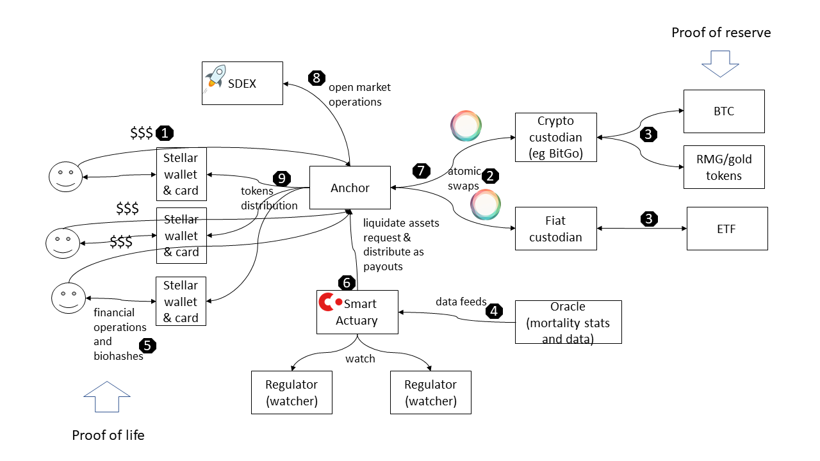
How does it work?

Slide 18
Tech details
Smart-actuary based on R3 Corda
EOS still under consideration
Settlement currency and assets tokenization in Stellar
Embedded SDEX
But also 3rd parties, like BitGo/RMG gold tokens
Atomic swaps of the asset between financial institutions using Interledger
Hyperledger Quilt
Proof of life biometric data (various providers)
ZoOm (3D face scan)
Face++
Fiat money withdrawals using credit cards
Tontine Trust

Slide 19
Thank you!
Poznań / Helsinki / San Francisco
espeoblockchain.com

